Slide 1
Multi-agent patrolling:
Coordinated Agents in Blackboard Cognitive Architecture (CABCA) and scope for RL
Meghdeep Jana

Slide 2
Contents
Introduction
Literature
Algorithm Performance
Observations and Shortcomings
Breaking Ties and Coordination
Results
Future Work

Slide 3
Introduction
Aim: Perform multi-agent patrolling optimally
Objectives:
Finding optimal set of trajectories to minimise the global average node visit idleness
Understand the capability of learning algorithms in finding the optimal patrolling strategy

Slide 4
Review Literature
In the literature by Machado et al. on Empirical Analysis of Multi-agent patrolling architectures[1]:
Approaches/architectures to MAP
Random Patrolling: Random walk through neighbouring nodes
Conscientious Reactive: Local Individual idleness
Blackboard Cognitive: Global shared idleness
The paper concludes that Conscientious Reactive is the best patrolling architecture to minimise average idleness.
Blackboard Cognitive performed poorly due to the multiple agents coalescing to act as a single agent
In the literature by Santana et al. on Reinforcement Learning for MAPP [2]:
Black-box learners (No coordination) will result in about 6,500 Markov Chain states and Gray-box( Coord. and Comm.) will result in 200,000 states thus inefficient use of Tabular Q-Learning approach.
The best reward function chosen is a ‘selfish utility’ local reward function
Notes:
2. Kudenko, Kazakov, Machine Learning for Agents and Multi-Agent Systems, Book published by Idea Group Inc., 2003
4. A. Machado, G. Ramalho, Multi-agent Patrolling: An Empirical Analysis of Alternative Architectures, in Lecture Notes in Computer Science, 2002
6. A. Almeida, G. Ramalho, Recent Advances on Multi-Agent Patrolling, Advances in Artificial Intelligence. SBIA’2004. LNAI 3171. pp. 526-535, 2004

Slide 5
Constraints and Assumptions [3]
Curse of dimensionality
Convergence
Partially Observable Environments
Communication
For now the assumptions are:
Homogeneous agents
Fully observable environment
Centralised communication
Notes:
5. Almeida, G. Ramalho, Recent Advances in MAPP, AAMAS’04, USA, 2004.

Slide 6
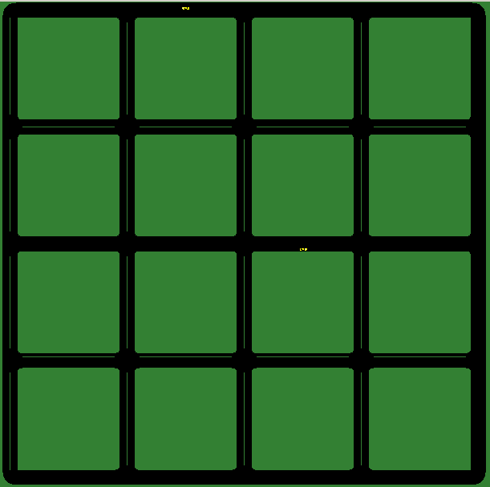
The environment
5x5 grid network
SUMO Simulator

Slide 7
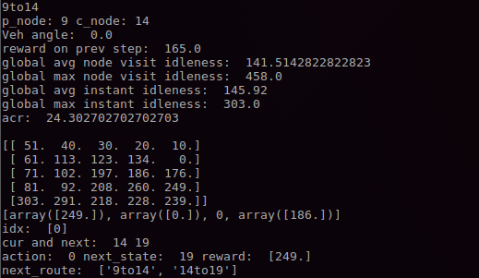
Single Agent - Conscientious Reactive

Slide 8
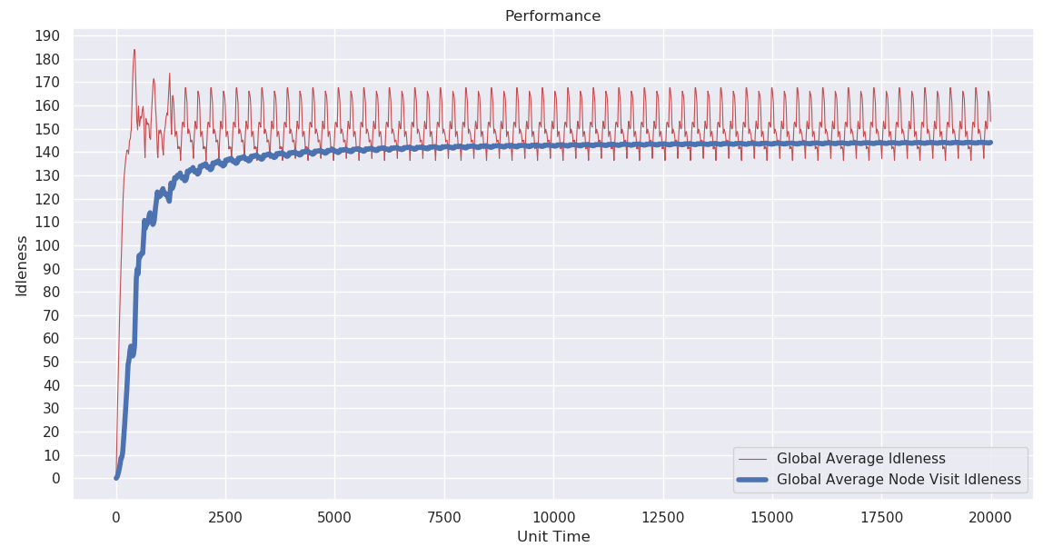
Single Agent - Conscientious Reactive
Notes:
7. Richard S. Sutton and Andrew G. Barto. 2018. Introduction to Reinforcement Learning (2nd. ed.). MIT Press, Cambridge, MA, USA.
Also explain about discounted return and farsightedness

Slide 9
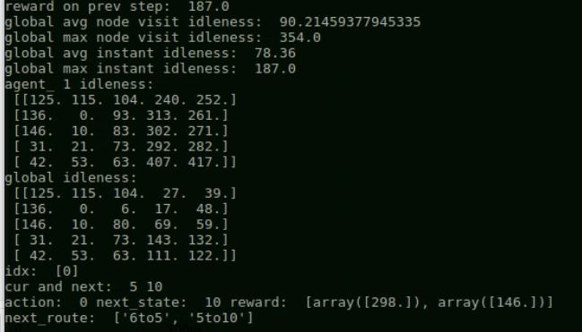
2 Agents - Conscientious Reactive
Notes:
7. Richard S. Sutton and Andrew G. Barto. 2018. Introduction to Reinforcement Learning (2nd. ed.). MIT Press, Cambridge, MA, USA.
Also explain about discounted return and farsightedness

Slide 10
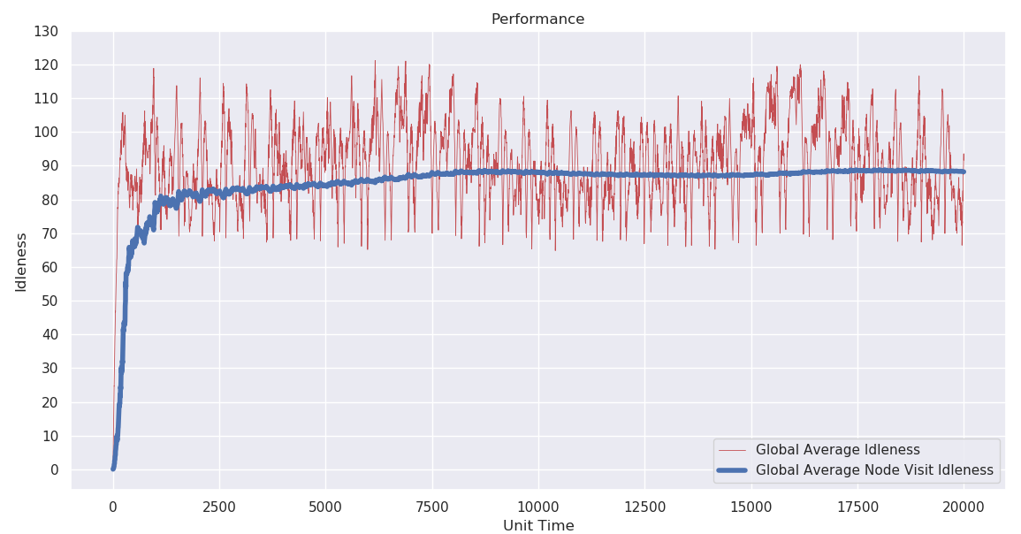
2 Agents - Conscientious Reactive
Notes:
7. Richard S. Sutton and Andrew G. Barto. 2018. Introduction to Reinforcement Learning (2nd. ed.). MIT Press, Cambridge, MA, USA.
Also explain about discounted return and farsightedness

Slide 11
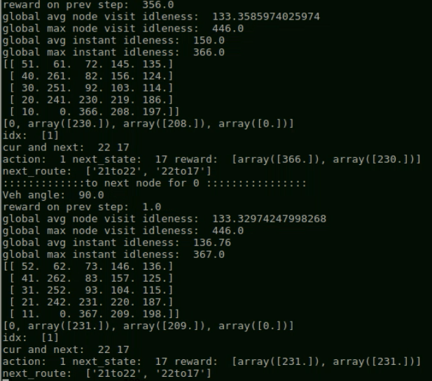
2 Agents -
Blackboard
Cognitive
Notes:
7. Richard S. Sutton and Andrew G. Barto. 2018. Introduction to Reinforcement Learning (2nd. ed.). MIT Press, Cambridge, MA, USA.
Also explain about discounted return and farsightedness

Slide 12
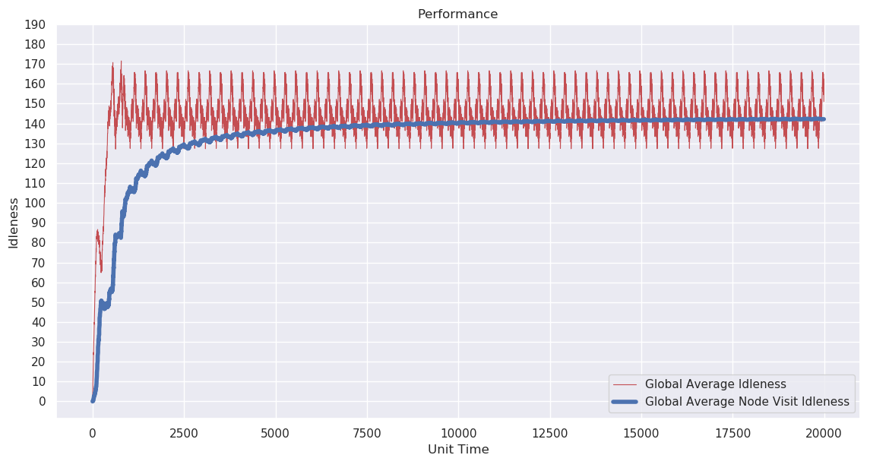
2 Agents - Blackboard Cognitive
Notes:
7. Richard S. Sutton and Andrew G. Barto. 2018. Introduction to Reinforcement Learning (2nd. ed.). MIT Press, Cambridge, MA, USA.
Also explain about discounted return and farsightedness

Slide 13
Observations and Shortcomings
The global idleness shows a initial transitory phase when the agents are exploring the environment, and then the agents soon converge to a stable phase and follow a set trajectory.
Conscientious Reactive significantly lowers average global idleness from 140-150 for single agent case to about 90 for 2 agents case.
Blackboard cognitive looks promising initially but soon the agents coalesce at a node and act as a single agent for the remainder of the simulation, showing about 140-150 average global idleness for both single and two agent cases.
There is no coordination between agents for blackboard cognitive case, and the shared idleness values forces the pseudo single agent.

Slide 14
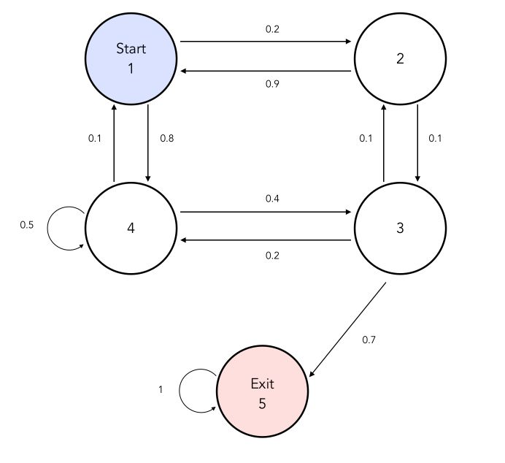
Breaking ties and pseudo-single agent scenario
Model the patrolling problem as a Markov Decision Process using SUMO and TraCI
Reward:

Slide 15
Breaking ties and pseudo-single agent scenario
Communication of previous node, current edge and next-node (intention) between the agents
In the MDP model, ‘next-node’ is set to a non-positive reward for the 2nd agent, thus making the associated action as ‘forbidden’.
Agents performing patrolling in such an MDP model, do not form pseudo-single agent for blackboard cognitive scenario
Calling this the “Coordinated Agents in Blackboard Cognitive Architecture (CABCA)
New Reward = -1 or 0

Slide 16
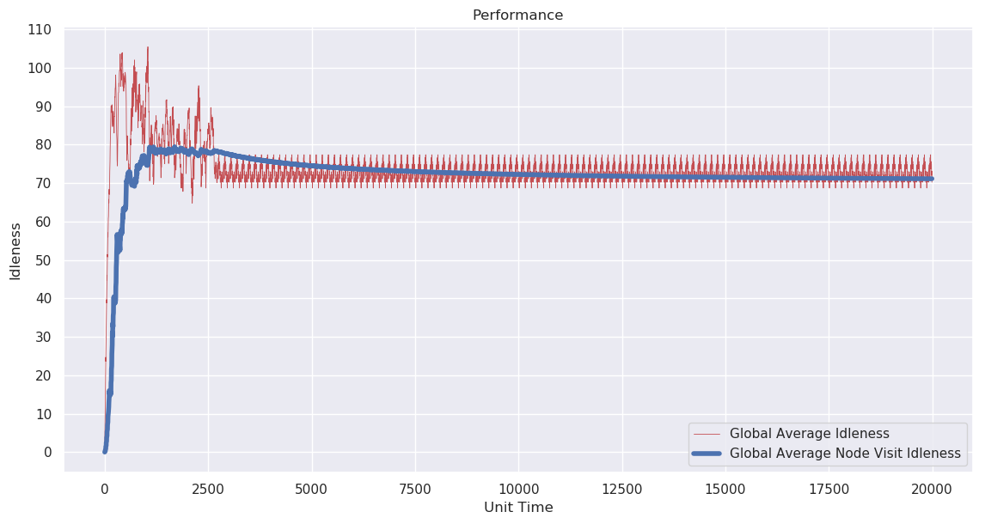
Result - Global average idleness for CABCA (2 agents)

Slide 17
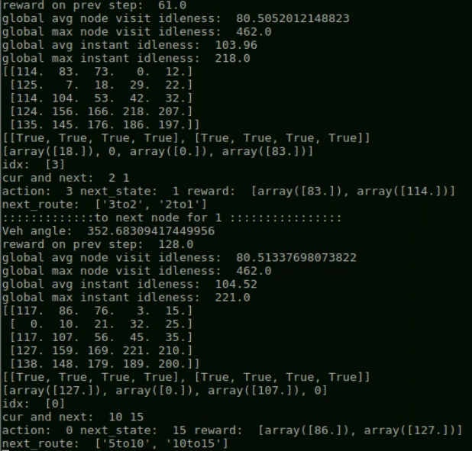
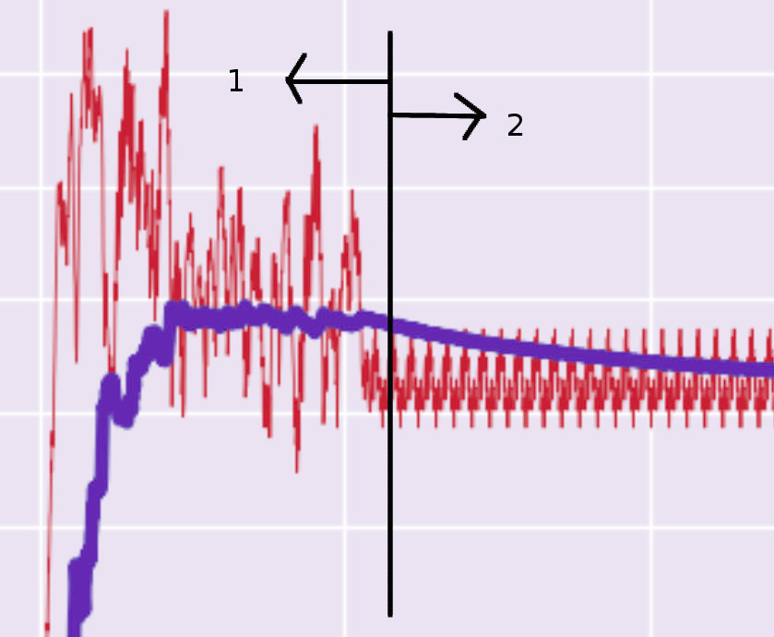
Result -
CABCA (2 agents)

Slide 18
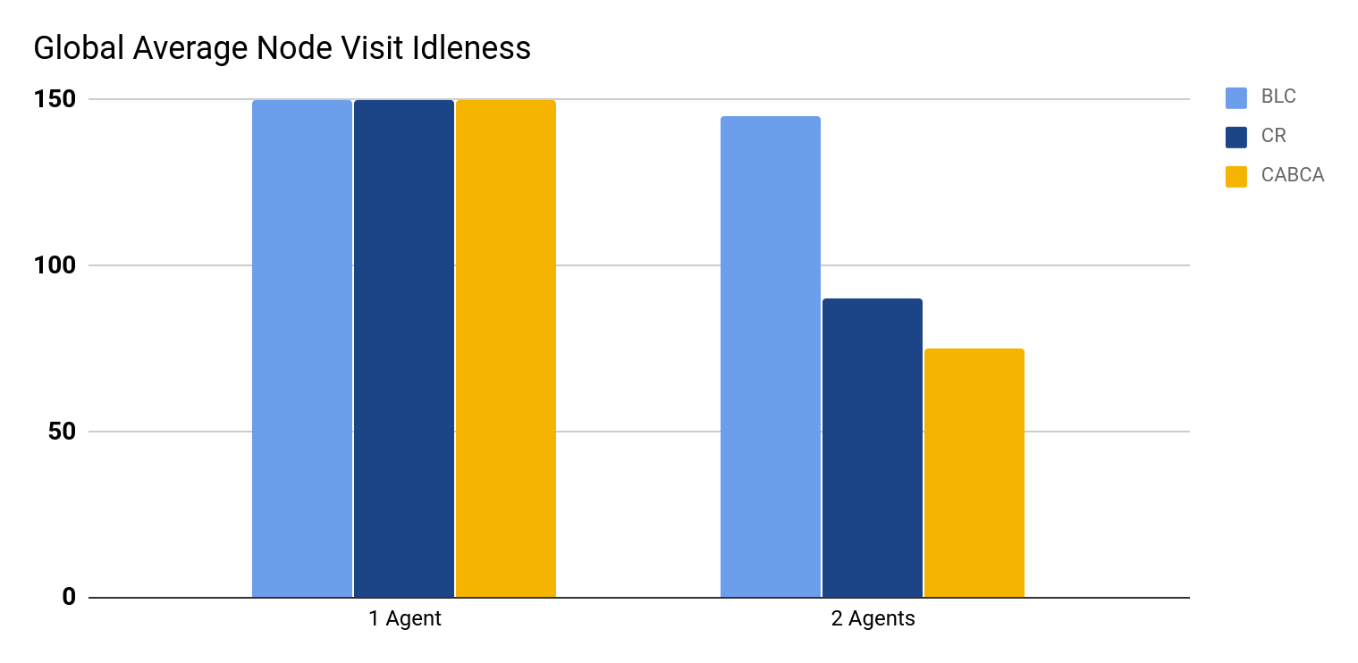
Result

Slide 19
RL as the answer?
What if breaking ties is suboptimal for some states in the MDP?
The algorithms in stable phase forms a cyclic trajectory, creating patterns that adversaries can exploit. What about randomness?
Reinforcement Learning is capable of finding optimal policies(trajectories) subject to a far-sighted long term reward function
Algorithms like Q-learning are off-policy learners that choose actions based on epsilon-greedy strategies, thus adding randomness to the trajectories[4]
RL algorithms are based on the markov assumption, thus can be implemented on a Markov Decision Process based model

Slide 20

Reinforcement Learning

Slide 21
Future Work
Implementation of Deep-Independent-Q-Network for function approximation of states (tackle curse of dimensionality as put forward by Santano et al.)
Experiment with reward functions, state and action space definitions on DQ-learning for multi-agent patrolling
Goal: To minimise ‘global average node visit idleness’
Compare results with state-of-the-art algorithms for various number of agents and different environments (graph structure) [3]

Slide 22
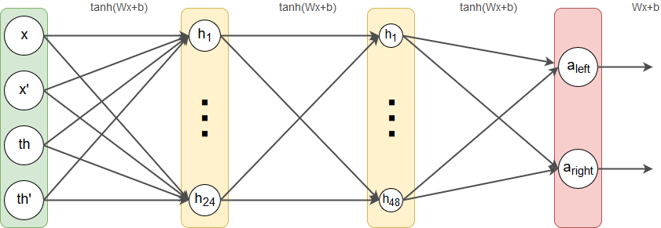
Function Approximation: Deep Q-Network
For continuous or high dimensional state space systems, it is impossible to represent them in a tabular format[4]
Deep Neural Networks are hence used to estimate the Q-functions and states from the observed/experienced states and rewards
Notes:
From Sutton and Barto

Slide 23
References
A. Machado, G. Ramalho, Multi-agent Patrolling: An Empirical Analysis of Alternative Architectures, in Lecture Notes in Computer Science, 2002
H. Santana, G. Ramalho, Multi-Agent Patrolling with Reinforcement Learning, AAMAS’04, USA, 2004.
A. Almeida, G. Ramalho, Recent Advances on Multi-Agent Patrolling, Advances in Artificial Intelligence. SBIA’2004. LNAI 3171. pp. 526-535, 2004
Richard S. Sutton and Andrew G. Barto. 2018. Introduction to Reinforcement Learning (2nd. ed.). MIT Press, Cambridge, MA, USA.

Slide 24
THANK YOU

